Slide 1
Figures – Chapter 1

Slide 2
Figure 1.1 Frequently asked questions about software engineering
Question | Answer
What is software? | Computer programs and associated documentation. Software products may be developed for a particular customer or may be developed for a general market.
What are the attributes of good software? | Good software should deliver the required functionality and performance to the user and should be maintainable, dependable and usable.
What is software engineering? | Software engineering is an engineering discipline that is concerned with all aspects of software production.
What are the fundamental software engineering activities? | Software specification, software development, software validation and software evolution.
What is the difference between software engineering and computer science? | Computer science focuses on theory and fundamentals; software engineering is concerned with the practicalities of developing and delivering useful software.
What is the difference between software engineering and system engineering? | System engineering is concerned with all aspects of computer-based systems development including hardware, software and process engineering. Software engineering is part of this more general process.
What are the key challenges facing software engineering? | Coping with increasing diversity, demands for reduced delivery times and developing trustworthy software.
What are the costs of software engineering? | Roughly 60% of software costs are development costs, 40% are testing costs. For custom software, evolution costs often exceed development costs.
What are the best software engineering techniques and methods? | While all software projects have to be professionally managed and developed, different techniques are appropriate for different types of system. For example, games should always be developed using a series of prototypes whereas safety critical control systems require a complete and analyzable specification to be developed. You can’t, therefore, say that one method is better than another.
What differences has the web made to software engineering? | The web has led to the availability of software services and the possibility of developing highly distributed service-based systems. Web-based systems development has led to important advances in programming languages and software reuse.

Slide 3
Figure 1.2 Essential attributes of good software
Product characteristic | Description
Maintainability | Software should be written in such a way so that it can evolve to meet the changing needs of customers. This is a critical attribute because software change is an inevitable requirement of a changing business environment.
Dependability and security | Software dependability includes a range of characteristics including reliability, security and safety. Dependable software should not cause physical or economic damage in the event of system failure. Malicious users should not be able to access or damage the system.
Efficiency | Software should not make wasteful use of system resources such as memory and processor cycles. Efficiency therefore includes responsiveness, processing time, memory utilisation, etc.
Acceptability | Software must be acceptable to the type of users for which it is designed. This means that it must be understandable, usable and compatible with other systems that they use.

Slide 4
Figure 1.3 The ACM/IEEE Code of Ethics

Slide 5
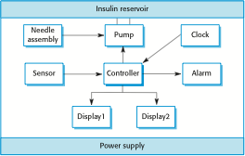
Figure 1.4 Insulin pump hardware architecture

Slide 6
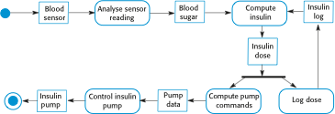
Figure 1.5 Activity model of the insulin pump

Slide 7
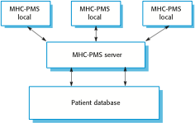
Figure 1.6 The organization of the MHC-PMS

Slide 8

Figure 1.7 The weather station’s environment

